Slide 1
Unity is …
ChengLiang
Product Evangelist
Notes:
Say hello
Self introduction, product evangelist 10+ developer, game industry,
I think unity bring a whole new development mode for the game industry,
Small and medium-sized developers successful product，
and in result, Unity most popular game engine.
So I am very glad to join unity, and engaged in the promotion of unity.
And today ‘s topic is what is Unity?

Slide 2
A most popular game engine
Easy to learn
Strong power of multiplatform, graphic and performance
A wider range of applications
used in medical, education, film / TV , architecture and other fields
A service platform across the product cycle
Ads, Analytics, Connect and etc.
Notes:
Nowadays, the first impression of unity
Today, I want to tell you, not only a game engine,
What more, a service platform
Ads help product profit
Analytics, statistics and analysis of game operations data， like DAU, MAU and so on.
Connect, the first talent marketplace dedicated to the full spectrum of unity creators. Like programmer, artist and others.
So like I said before, unity brings whole development mode in game industry and we hope to help more develops to achieve success.

Slide 3
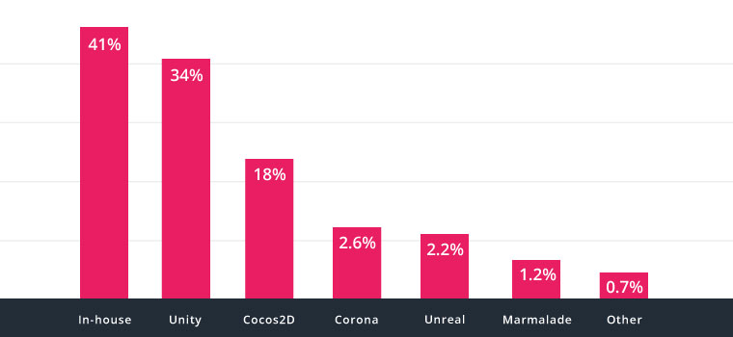
The most popular game engine
Rank Top 1000 free games, 34% made with Unity
Source: source DNA, first quarter of 2016
Notes:
We are also very glad to accepted by lots of developers
According to source DNA, at first quarter of 2016 , 34% of top 1000 free games are made with Unity，almost double the second place.
In fact, The proportion of Unity as the main development tool is increasing all the time ，and more and more developer turn to Unity.
I am one the them.

Slide 4
Learn with Unity
Tutorials
Documentation
Live training
Community
Notes:
One of the reasons why Unity becomes popular is easy to learn.
In addition to the easy-to-use unity editor, we also offer many ways to learn unity.
We supply lots of video and text tutorials in the official website. Of course, You also can find lots of tutorials by google.
We supply detailed document for how to use unity.
We also have live trainings, which can make us to communicate and interact with the developers
Of course, we also know the importance of the mutual communication. So we supply forums and answers platform.
We ‘ll try our best to reduce the barriers to learning unity

Slide 5
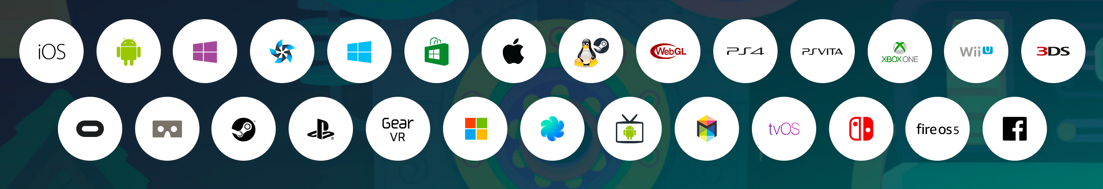
Multiplatform
Publish your game to over 25 platforms
Notes:
Of course, Unity is not only easy to learn, but also have strong power
One of the power I want to mention is Multiplatform.
More platform means more users
25 platform, Across the mobile, desktop, console, TV, VR, AR and web platform
You don’t warry about system API, Texture format, Unity handle those staff for u

Slide 6
Graphic
Real-time Global Illumination, physically-based shader
Access to fast native graphics API
like Vulkan, iOS Metal, DirectX12, nVidia VRWorks or AMD LiquidVR.
Post Processing Stack
Effect: Antialiasing (FXAA, Temporal AA), Ambient Occlusion, Screen Space Reflections, Fog, Depth of Field, Motion Blur and etc.
Combine many effects info single pass.
Notes:
The next power is graphic
Our graphic system can help you game to reach AAA product quality
At this time, I want to talk about 3 point3
Unity implements GI and PBS
Through this global illumination system
Indirect light, for example look at the picture above, when the light reach the ball, it will bounce off from the ball, and then the floor can reflect the ball’s color.
Support latest graphic API, like Vulkan, iOS Metal and etc. To improve rendering performance.

Slide 7
Engine Performance
Advanced profiling tools
CPU, GPU, Memory, Rendering, Physics, UI, Audio
Native C++ performance
across platforms with ILCPP continues to get better
Notes:
Ok, The last power I want to mention Engine Performance
First, I’d like to say Unity keeps on improving its performance
Then I want to talk about 2 points. One is that we supply advanced profiling tools to help you optimize your game.
The profiling tools can help you analyze the usage of CPU, GPU, memory and etc.
The second one is that Unity supply IL2CPP technology to convert script to native C++ in building time. By using
This IL2CPP, your product can gain a lot of performance increasing.

Slide 8
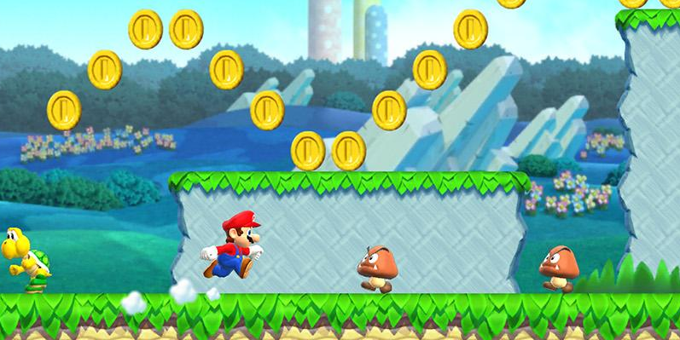
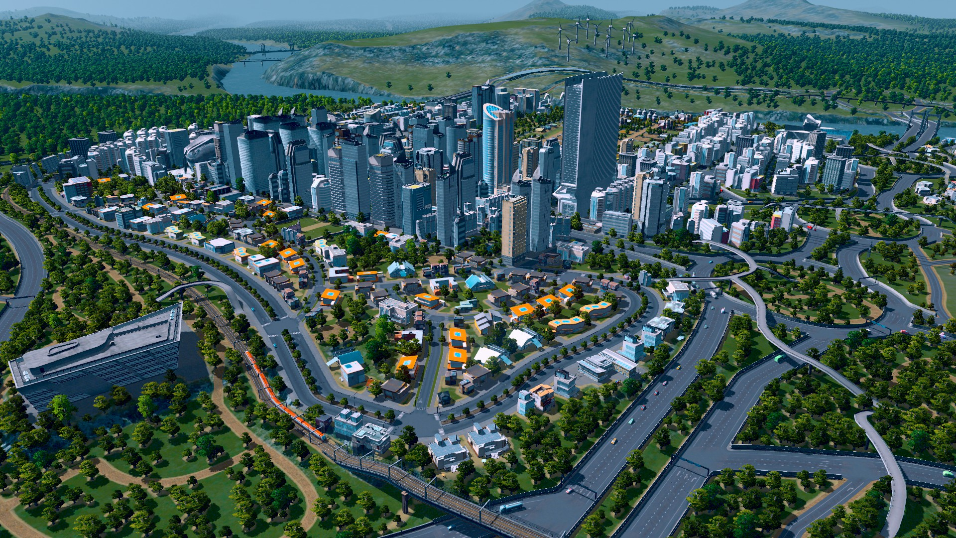
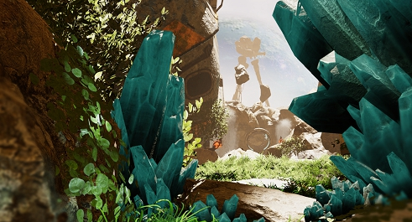
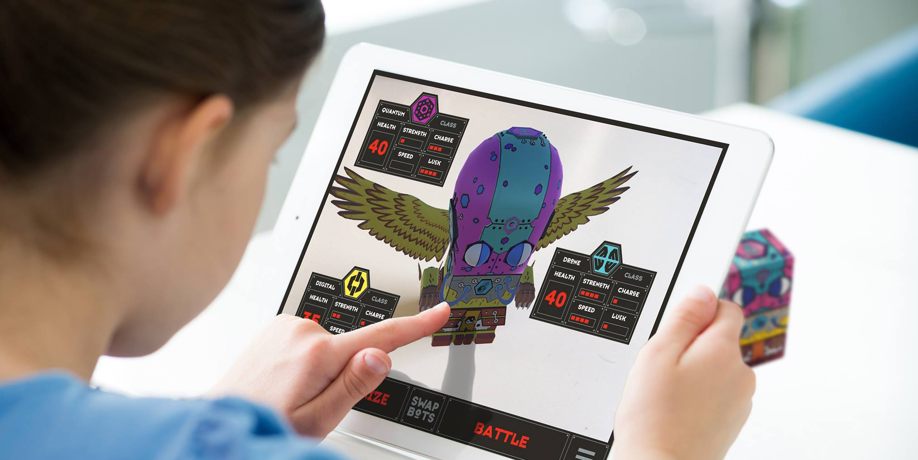

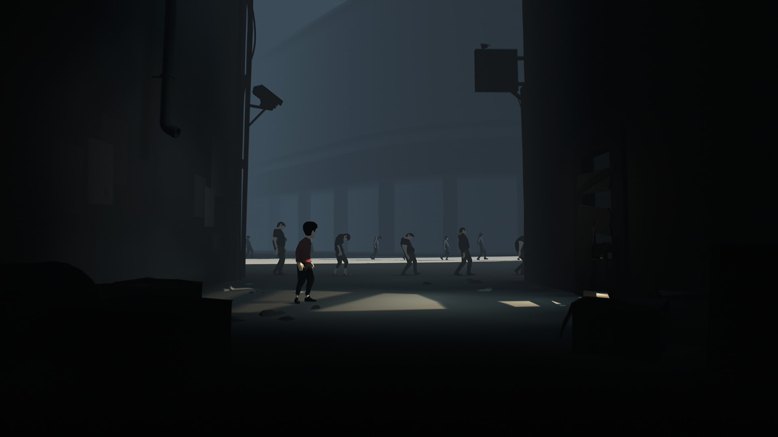
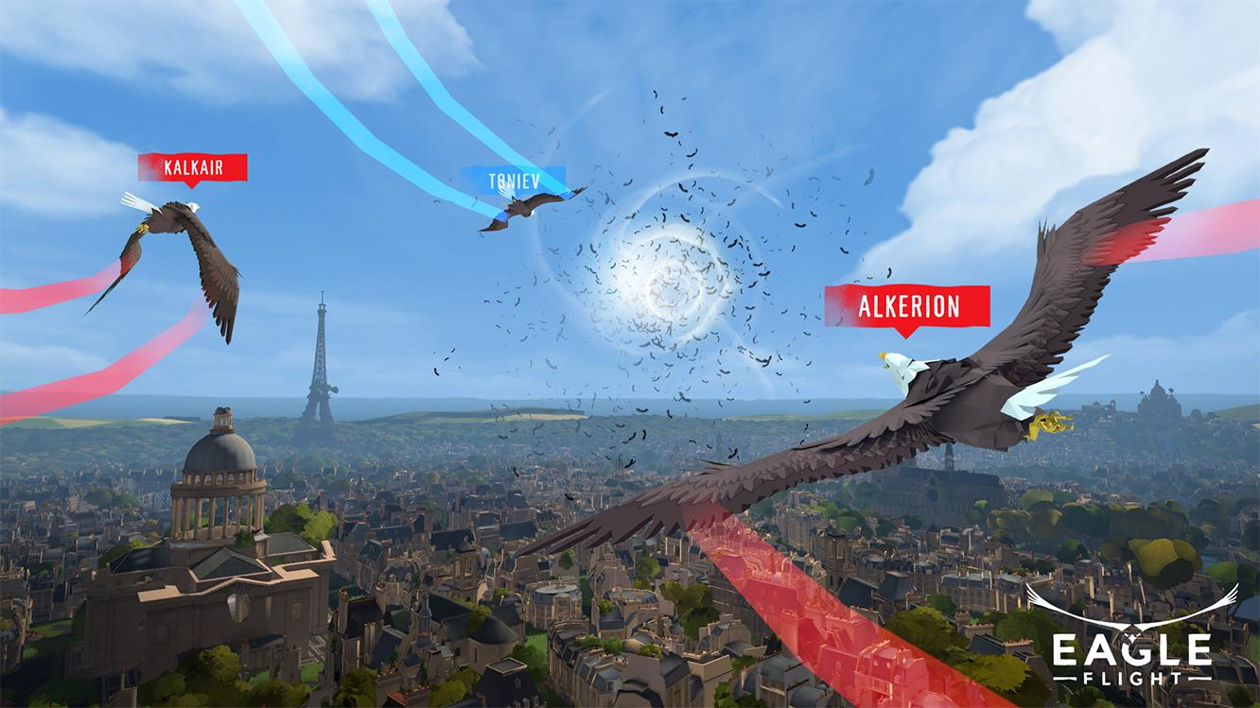
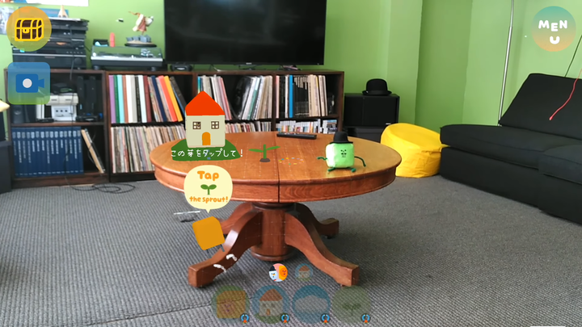
Made with Unity
Mobile
PC
VR
AR/Mixed Reality
Super Mario Run
Nintendo
Cities Skylines
Colossal Order
Seeking Dawn
Multiverse
Swapbots
SwapBots
Monument Valley
ustwo
INSIDE
Playdead
Eagle Flight
Ubisoft
Woorld
Funomena
Notes:
Now it’s glad to see there are lots of great games made with Unity.
Across different platforms, such as mobile, pc, vr , ar and etc.

Slide 9
A wider range of applications
Education
Medical
Automobile
Film/TV
Architecture
…
Notes:
At the same time, it also very happy to see Unity has a wider range of applications in other fiels.

Slide 10
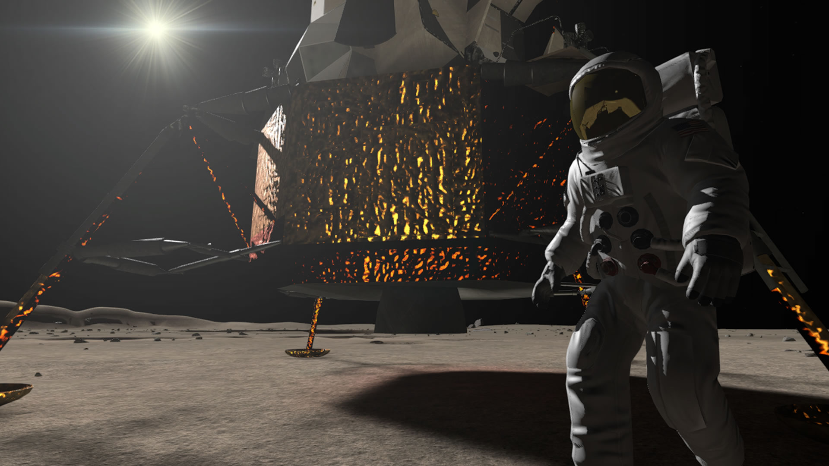
Education
Apollo 11 VR
Notes:
Apollo 11 VR is an application of space education.
Through this application, you can personally experience this great historic event.
based VR technology, and with the use of the original archived audio and video, this application creates a very real experience.
When you sit in the cockpit, accompanied by inspiring music, waiting for the moment of lau
nch. You will also feel that this is a great moment in human history, and pay great respect for the people who work for Apollo plan.
I’d like to say it’s really cool application. As far as now, applications made with Unity like this become more and more.

Slide 11
Unity Services
Prepare
Developing
published
connect
Performance reporting
analytics
…
Cloud building
Ads
…
…
Notes:
The last part is about unity service, in order to better help developers, unity offers many services in whole product cycle.
In preparation phase, you can use connect service to find talent.
In developing phase, use cloud building to create and share builds of product, use performance reporting to collect application errors automatically.
After product published, you can use analytic to analysis operations data, use Ads to profit your product.

Slide 12
Unity Ads
The largest video ad network in the gaming industry
1 billion global players
Help many small and medium developers to achieve profitability
“Using Unity Ads, Analytics & IAP as a whole, we’ve experienced an increase in ad revenue of over 60% and IAP sales in our games grew by over 70%.”
Majid Khosravi, Founder and CEO of Twimler
Notes:
Now, I’d like to talk about unity’s ads service.
the largest video ad network in the gaming industry, with more than 1billion global players, and your ads can be presented to all players through the network.
As far as now , the Ads services help many small and medium developers to achieve profitability.
Twimler is one of those developers, after using ads, analytics & IAP service, their ad revenue increase over 60% and IAP sales increase 70%.

Slide 13
This is unity
?
Game engine
Service platform
2004
2017
Notes:
From a game engine , after more than 10 years development, becomes a service platform to help developer in the whole product cycle.
In the future, we will keep offering more high quality services for unity developers.

Slide 14
Thanks
chengliang@unity3d.com

